Slide 1

Frontiers of Network Science
Fall 2023
Class 6: Scale Free Networks and Barabasi Model
(Chapters 4-5 in Textbook)
Boleslaw Szymanski
based on slides by Albert-László Barabási & Roberta Sinatra

Slide 2
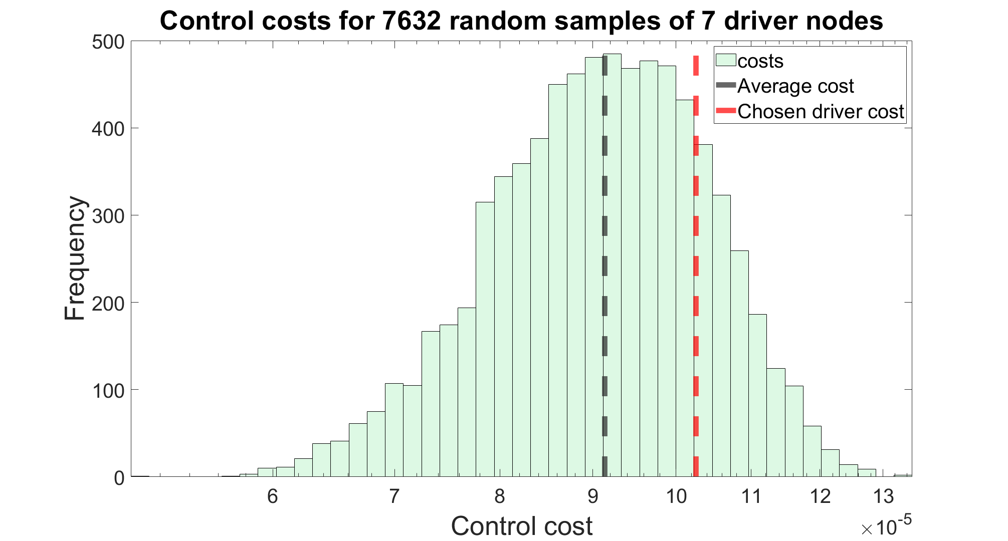
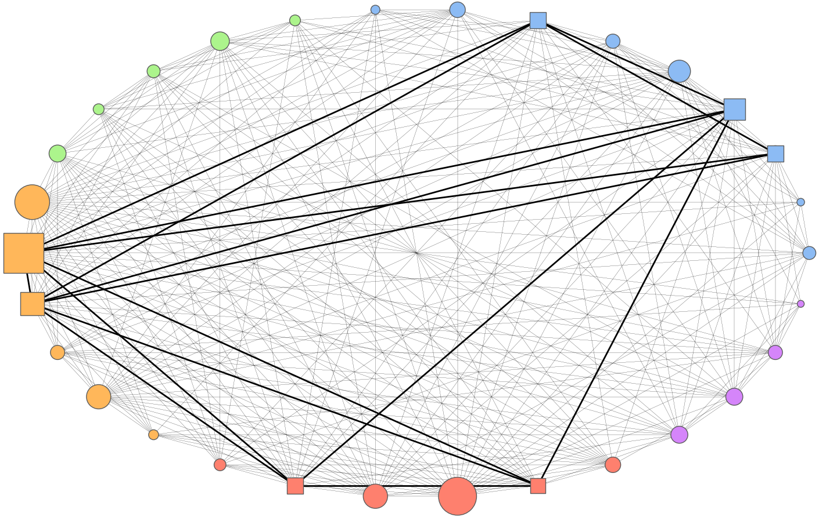
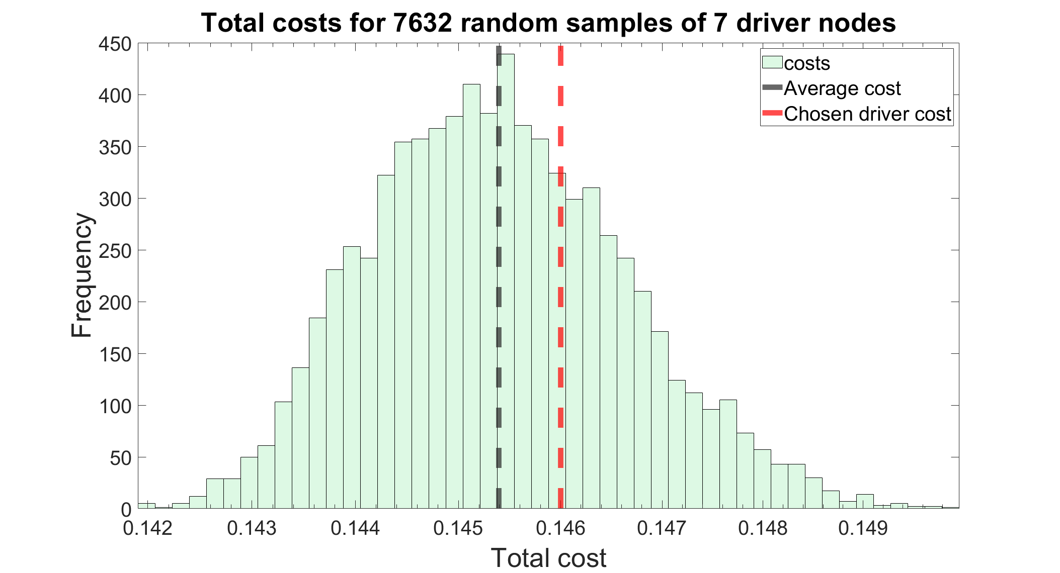
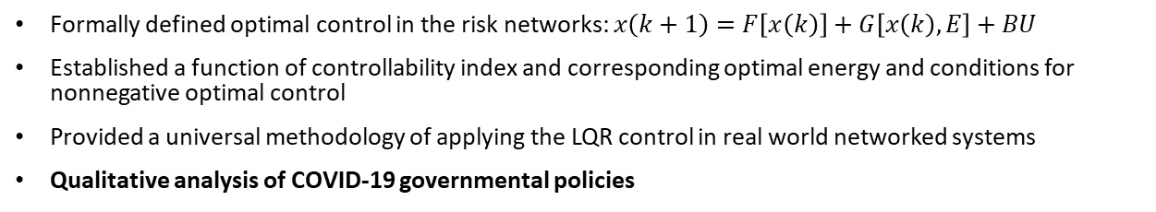
Example: COVID-19 Control
Formally defined optimal control in the risk networks: $x\left(k+1\right)=F\left[x\left(k\right)\right]+G\left[x\left(k\right),E\right]+BU$
Established a function of controllability index and corresponding optimal energy and conditions for nonnegative optimal control
Provided a universal methodology of applying the LQR control in real world networked systems
Qualitative analysis of COVID-19 governmental policies

Slide 3


Optimize functions
Low cost of intermediate states

Slide 4
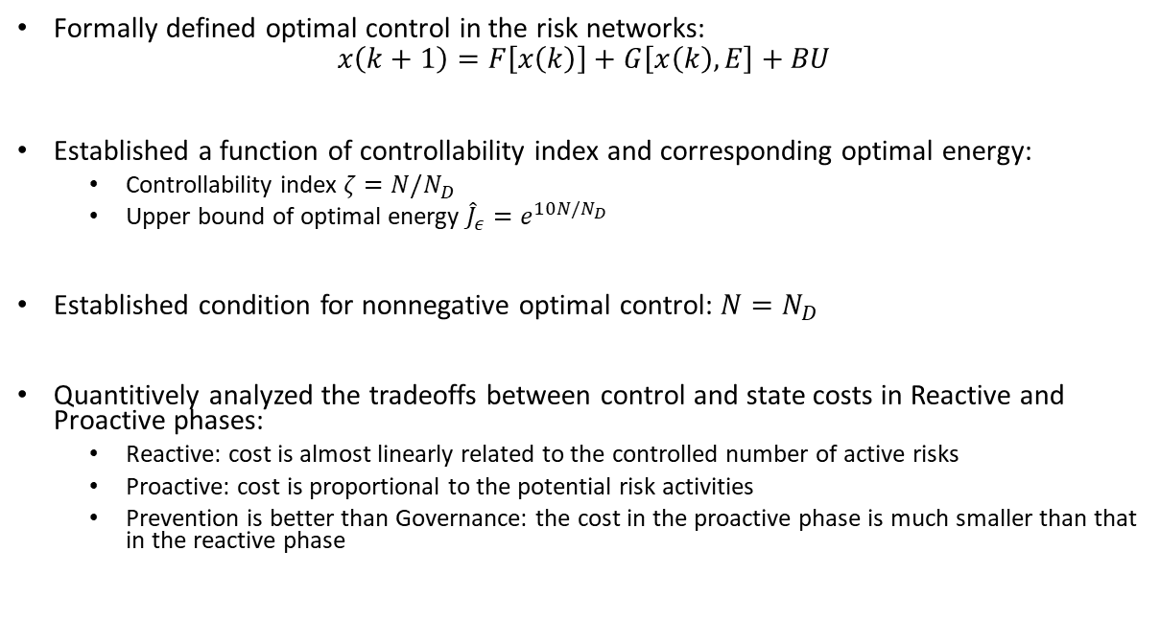
Contributions:
Formally defined optimal control in the risk networks:
$$x\left(k+1\right)=F\left[x\left(k\right)\right]+G\left[x\left(k\right),E\right]+BU$$
Established a function of controllability index and corresponding optimal energy:
  Controllability index $ζ=N/N_{D}$
  Upper bound of optimal energy ${\hat{J}}_{ε}=e^{10N/N_{D}}$
Established condition for nonnegative optimal control: $N=N_{D}$
Quantitively analyzed the tradeoffs between control and state costs in Reactive and Proactive phases:
  Reactive: cost is almost linearly related to the controlled number of active risks
  Proactive: cost is proportional to the potential risk activities
  Prevention is better than Governance: the cost in the proactive phase is much smaller than that in the reactive phase

Slide 5
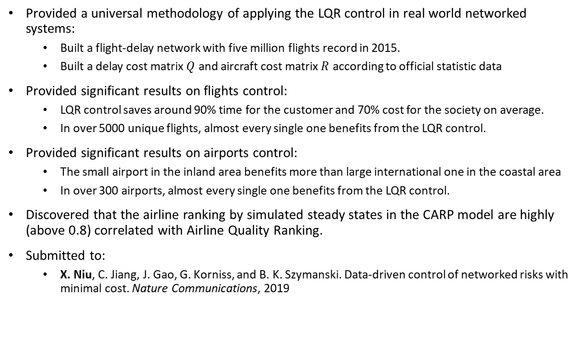
Contributions:
Provided a universal methodology of applying the LQR control in real world networked systems:
  Built a flight-delay network with five million flights record in 2015.
  Built a delay cost matrix $Q$ and aircraft cost matrix $R$ according to official statistic data
Provided significant results on flights control:
  LQR control saves around 90% time for the customer and 70% cost for the society on average.
  In over 5000 unique flights, almost every single one benefits from the LQR control.
Provided significant results on airports control:
  The small airport in the inland area benefits more than large international one in the coastal area
  In over 300 airports, almost every single one benefits from the LQR control.
Discovered that the airline ranking by simulated steady states in the CARP model are highly (above 0.8) correlated with Airline Quality Ranking.
Submitted to:
  X. Niu, C. Jiang, J. Gao, G. Korniss, and B. K. Szymanski. Data-driven control of networked risks with minimal cost. Nature Communications, 2019

Slide 6
Questions?

Slide 7
Section 2
Power laws and scale-free networks
Network Science: Scale-Free Networks

Slide 8
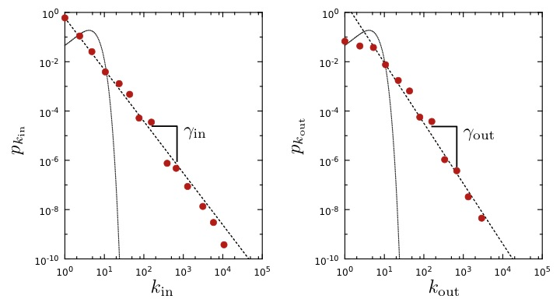
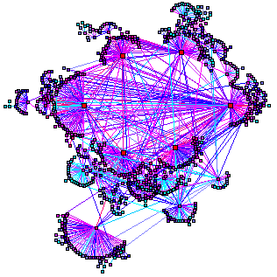
WORLD WIDE WEB
Nodes: WWW documents Links: URL links
Over 3 billion documents
ROBOT: collects all URL’s found in a document and follows them recursively
Expected
R. Albert, H. Jeong, A-L Barabasi, Nature, 401 130 (1999).
Network Science: Scale-Free Networks

Slide 9

Discrete vs. Continuum formalism
Discrete Formalism
As node degrees are always positive integers, the discrete formalism captures the probability that a node has exactly k links:
Continuum Formalism
In analytical calculations it is often convenient to assume that the degrees can take up any positive real value:
INTERPRETATION:
Network Science: Scale-Free Networks
Notes:
There appears to be little difference between them at the first look. Yet. There is some quite relevant different: the at high degrees the power law curve is always higher than the exponential.

Slide 10
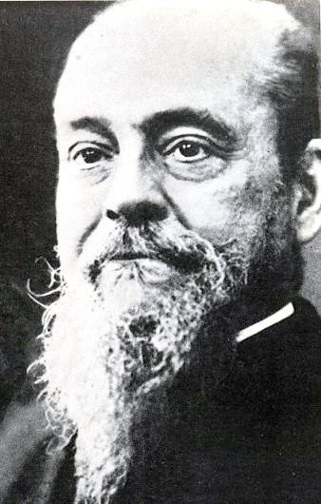
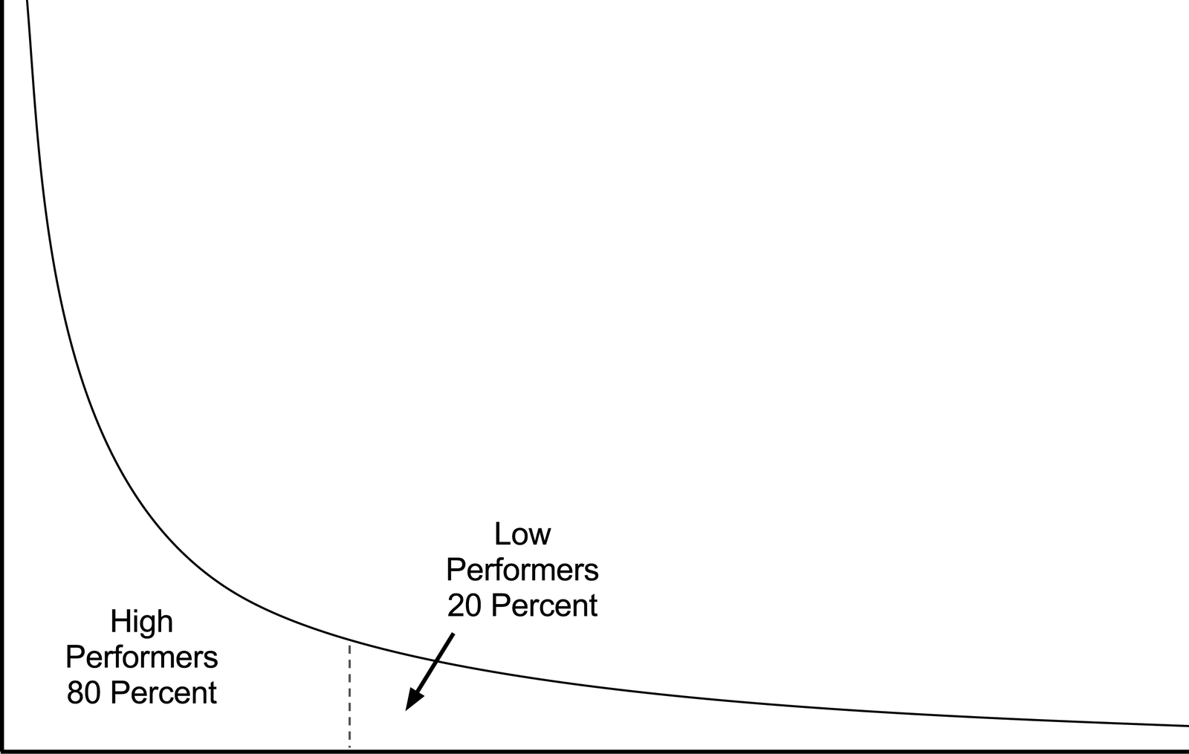
80/20 RULE
Vilfredo Federico Damaso Pareto (1848 – 1923), Italian economist, political scientist and philosopher, who had important contributions to our understanding of income distribution and to the analysis of individuals choices. A number of fundamental principles are named after him, like Pareto efficiency, Pareto distribution (another name for a power-law distribution), the Pareto principle (or 80/20 law).
Notes:
Vilfredo Pareto, a 19th century economist, noticed that in Italy a few wealthy individuals earned most of the money, while the majority of the population earned rather small amounts. He connected this disparity to the observation that incomes follow a power law, representing the first known report of a power law distribution [3]. His finding entered the popular literature as the 80/20 rule: roughly 80 percent of money is earned by only 20 percent of the population. The 80/20 emerges in many areas, like management, stating that 80 percent of profits are produced by only 20 percent of the employees or that 80 percent of decisions are made during 20 percent of meeting time. They are present in networks as well: 80 percent of links on the Web point to only 15 percent of webpages; 80 percent of citations go to only 38 percent of scientists; 80 percent of links in Hollywood are connected to 30 percent of actors [4]. Typically all quantities obeying the 80/20 rule follow a power law distribution. During the 2009 economic crisis power laws have gained a new meaning: the Occupy Wall Street Movement highlighted the fact that in the US 1% of the population earns a disproportionate 15% of the total US income. This 1% effect, a signature of a profound income disparity, is again a natural consequence of the power law nature of the income distribution.

Slide 11
The difference between a power law and an exponential distribution
Network Science: Scale-Free Networks
Notes:
There appears to be little difference between them at the first look. Yet. There is some quite relevant different: the at high degrees the power law curve is always higher than the exponential.

Slide 12
The difference between a power law and an exponential distribution
Let us use the WWW to illustrate the properties of the high-k regime.
The probability to have a node with k~100 is
About in a Poisson distribution
About if p_{k} follows a power law.
Consequently, if the WWW were to be a random network, according to the Poisson prediction we would expect 10⁻¹⁸ k>100 degree nodes, or none.
For a power law degree distribution, we expect about k>100 degree nodes
Network Science: Scale-Free Networks
Notes:
There appears to be little difference between them at the first look. Yet. There is some quite relevant different: the at high degrees the power law curve is always higher than the exponential.

Slide 13
Network Science: Scale-Free Networks
Notes:
There appears to be little difference between them at the first look. Yet. There is some quite relevant different: the at high degrees the power law curve is always higher than the exponential.

Slide 14
Finite scale-free networks
The size of the biggest hub
All real networks are finite → let us explore its consequences.
→ We have an expected maximum degree, k_{max}
Estimating k_{max}
Why: the probability to have a node larger than k_{max} should not exceed the prob. to have one node, i.e. 1/N fraction of all nodes
Network Science: Scale-Free Networks

Slide 15
Finite scale-free networks
The size of the biggest hub
Network Science: Scale-Free Networks

Slide 16
Finite scale-free networks
Expected maximum degree, k_{max}
k_{max}, increases with the size of the network
  →the larger a system is, the larger its biggest hub
For γ>2 k_{max} increases slower than N
  the largest hub will contain a decreasing fraction of links as N increases.
For γ=2 k_{max}~N.
  → The size of the biggest hub is O(N)
For γ<2 k_{max} increases faster than N: condensation phenomena
  → the largest hub will grab an increasing fraction of links. Anomaly!
Network Science: Scale-Free Networks

Slide 17
Finite scale-free networks
The size of the largest hub
Network Science: Scale-Free Networks

Slide 18
Section 4
The meaning of scale-free
Network Science: Scale-Free Networks

Slide 19
Scale-free networks: Definition
Definition:
Networks with a power law tail in their degree distribution are called
‘scale-free networks’
Where does the name come from?
Critical Phenomena and scale-invariance
(a detour)
Slides after Dante R. Chialvo
Network Science: Scale-Free Networks
Slides after Dante R. Chialvo

Slide 20
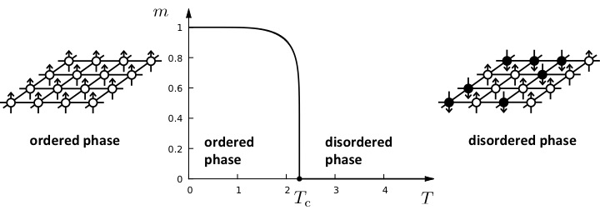

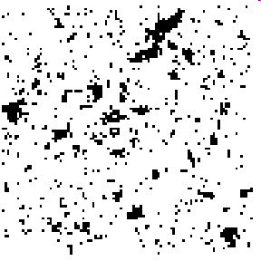
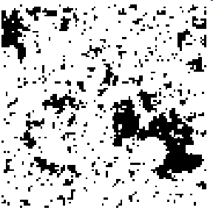
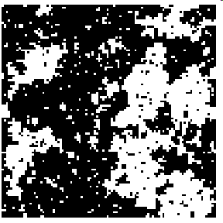
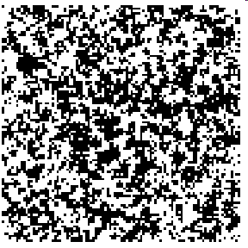
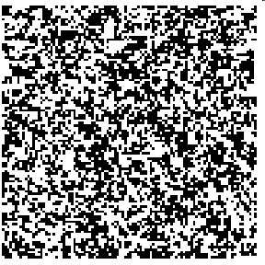

Phase transitions in complex systems I: Magnetism
T = 0.99 T_{c}
T = 0.999 T_{c}
T = T_{c}
T = 1.5 T_{c}
T = 2 T_{c}
ξ
ξ
Network Science: Scale-Free Networks

Slide 21
CRITICAL PHENOMENA
Correlation length diverges at the critical point: the whole system is correlated!
Scale invariance: there is no characteristic scale for the fluctuation (scale-free behavior).
Universality: exponents are independent of the system’s details.
Network Science: Scale-Free Networks
Notes:
Now we see where the ‘scale-free’ name comes from.
But what’s in the name?
We need to learn a bit more to understand that … soon
Before we get there, let us talk about universality.

Slide 22
Divergences in scale-free distributions
If m-γ+1<0:
If m-γ+1>0, the integral diverges.
For a fixed γ this means that all moments with m>γ-1 diverge.
Network Science: Scale-Free Networks

Slide 23
DIVERGENCE OF THE HIGHER MOMENTS
For a fixed γ this means all moments m>γ-1 diverge.
Network | N | L | 〈k〉 | 〈k_{in}²〉 | 〈k_{out}²〉 | 〈k²〉 | γ_{in} | γ_{out} | γ
Internet | 192,244 | 609,066 | 6.34 | - | - | 240.1 | - | - | 3.42*
WWW | 325,729 | 1,497,134 | 4.60 | 1546.0 | 482.4 | - | 2.00 | 2.31 | -
Power Grid | 4,941 | 6,594 | 2.67 | - | - | 10.3 | - | - | Exp.
Mobile-Phone Calls | 36,595 | 91,826 | 2.51 | 12.0 | 11.7 | - | 4.69* | 5.01* | -
Email | 57,194 | 103,731 | 1.81 | 94.7 | 1163.9 | - | 3.43* | 2.03* | -
Science Collaboration | 23,133 | 93,437 | 8.08 | - | - | 178.2 | - | - | 3.35*
Actor Network | 702,388 | 29,397,908 | 83.71 | - | - | 47,353.7 | - | - | 2.12*
Citation Network | 449,673 | 4,689,479 | 10.43 | 971.5 | 198.8 | - | 3.03* | 4.00* | -
E. Coli Metabolism | 1,039 | 5,802 | 5.58 | 535.7 | 396.7 | - | 2.43* | 2.90* | -
Protein Interactions | 2,018 | 2,930 | 2.90 | - | - | 32.3 | - | - | 2.89*-
Many degree exponents are smaller than 3
<k²> diverges in the N→∞ limit!!!
<k> diverges in the N→∞ limit!!!
Network Science: Scale-Free Networks

Slide 24
The meaning of scale-free
Network Science: Scale-Free Networks

Slide 25
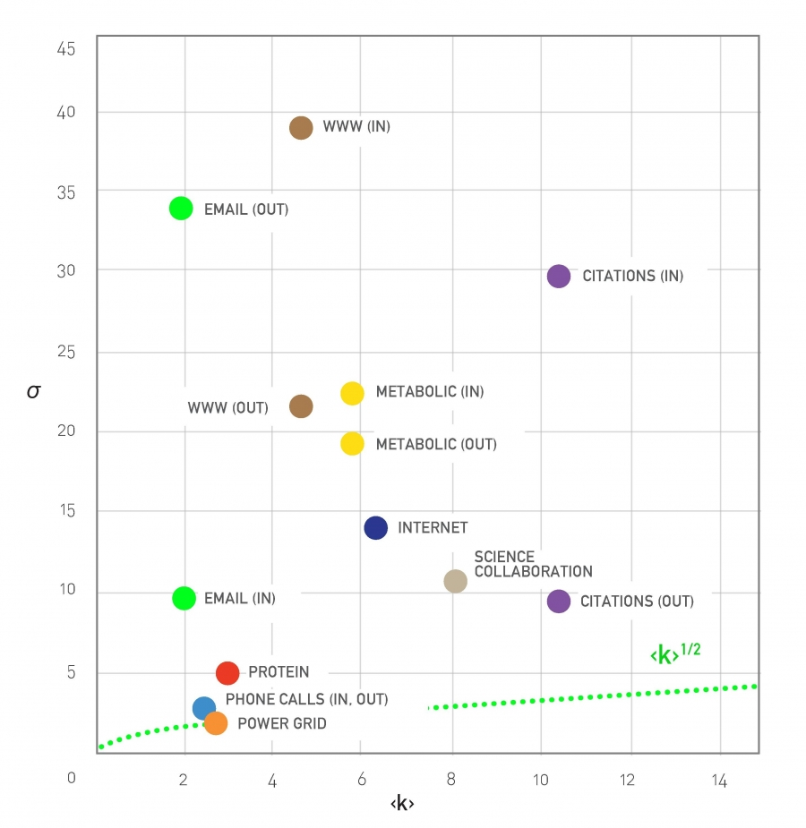
The meaning of scale-free
Network Science: Scale-Free Networks

Slide 26
Section 5
universality
Network Science: Scale-Free Networks

Slide 27
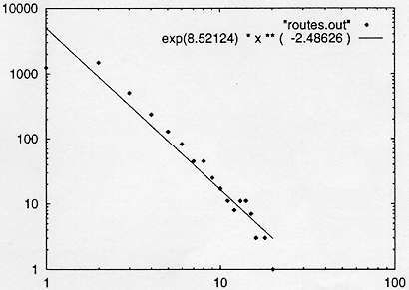
INTERNET BACKBONE
Nodes: computers, routers
Links: physical lines
(Faloutsos, Faloutsos and Faloutsos, 1999)
Network Science: Scale-Free Networks

Slide 28
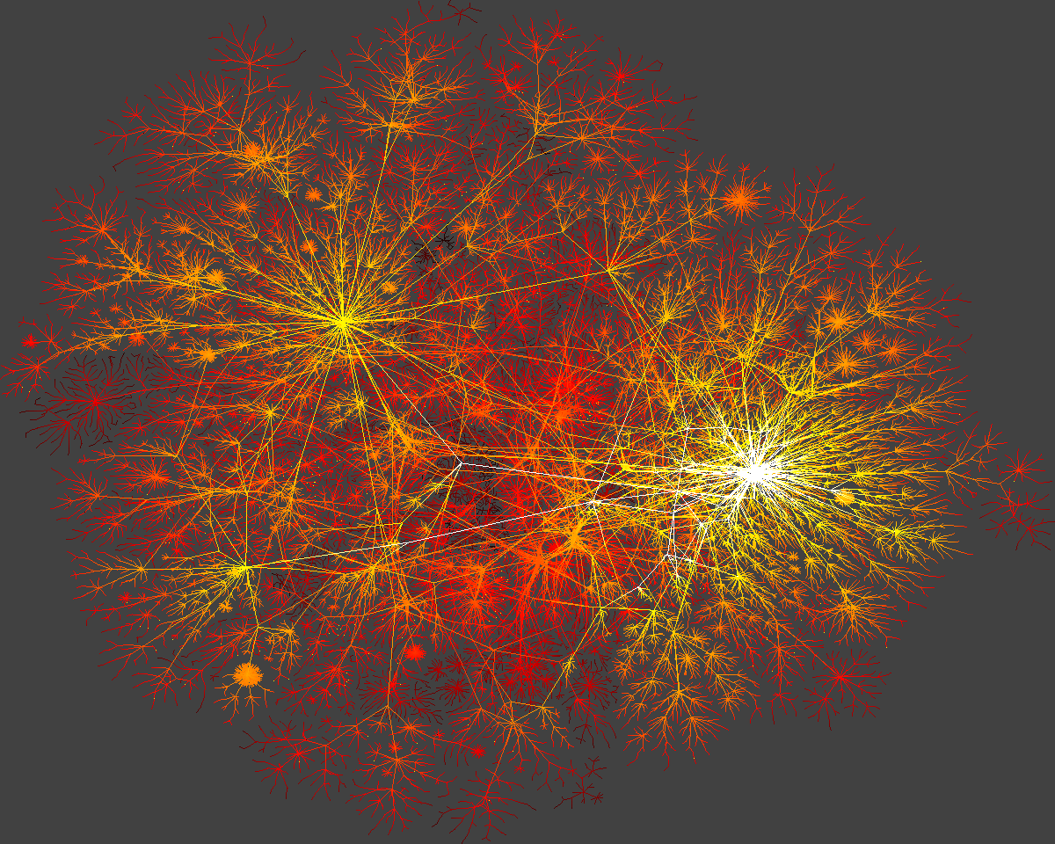
Network Science: Scale-Free Networks

Slide 29
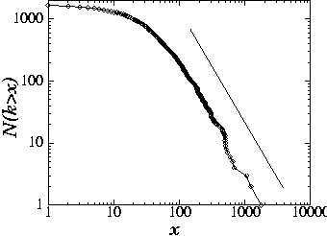
SCIENCE CITATION INDEX
Nodes: papers
Links: citations
25
H.E. Stanley,...
1736 PRL papers (1988)
578...
P(k) ~k^{-γ}
(γ = 3)
(S. Redner, 1998)
Network Science: Scale-Free Networks

Slide 30
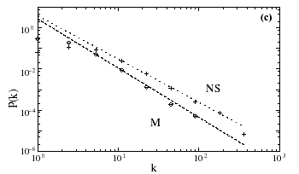
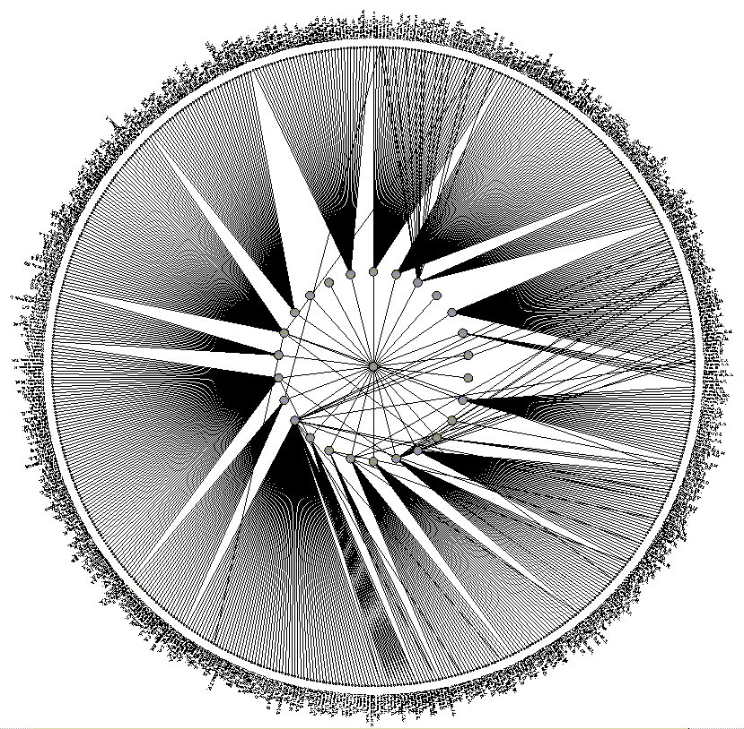
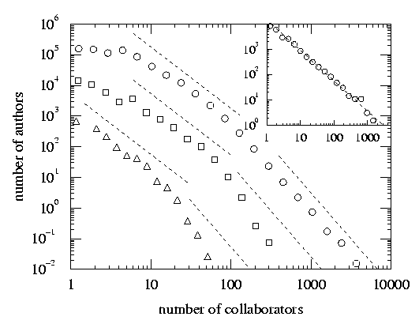
SCIENCE COAUTHORSHIP
Nodes: scientist (authors)
Links: joint publication
M: math
NS: neuroscience
(Newman, 2000, Barabasi et al 2001)
Network Science: Scale-Free Networks

Slide 31
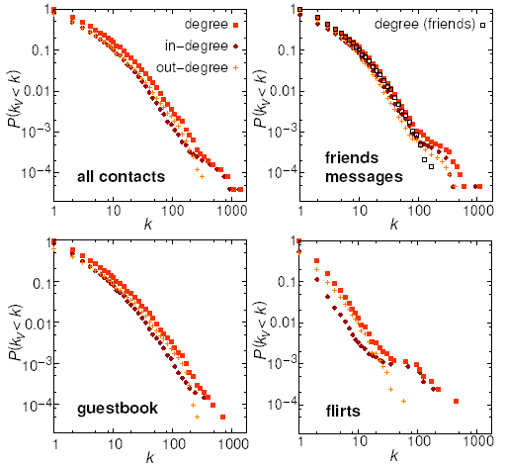
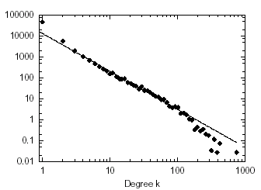
ONLINE COMMUNITIES
Nodes: online user
Links: email contact
Pussokram.com online community;
512 days, 25,000 users.
Kiel University log files
112 days, N=59,912 nodes
Ebel, Mielsch, Bornholdtz, PRE 2002.
Holme, Edling, Liljeros, 2002.
Network Science: Scale-Free Networks

Slide 32
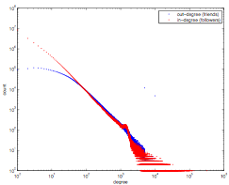
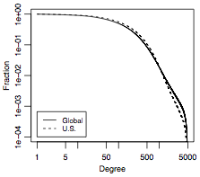
ONLINE COMMUNITIES
Twitter:
Facebook
Jake Hoffman, Yahoo,
Brian Karrer, Lars Backstrom, Cameron Marlowm ²⁰¹¹
Network Science: Scale-Free Networks
Notes:
FACEBOOK: The complementary cumulative distribution function (CCDF). The CCDF at degree k measures the fraction of users who have degree k or greater and in terms of the degree distribution is 􏰂k′ ≥k pk′ . For the U.S., the degree measures the number of friends also from the United States.

Slide 33
Section 2
Barabasi-Albert Model
Network Science: Scale-Free Networks

Slide 34
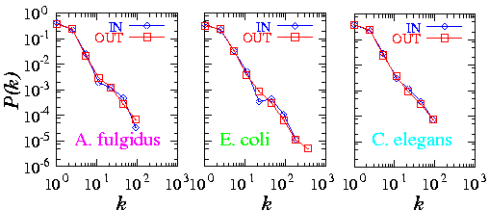
Meta-P(k)
METABOLIC NETWORK
Archaea
Bacteria
Eukaryotes
Organisms from all three domains of life are scale-free!
H. Jeong, B. Tombor, R. Albert, Z.N. Oltvai, and A.L. Barabasi, Nature, 407 651 (2000)
Network Science: Scale-Free Networks

Slide 35
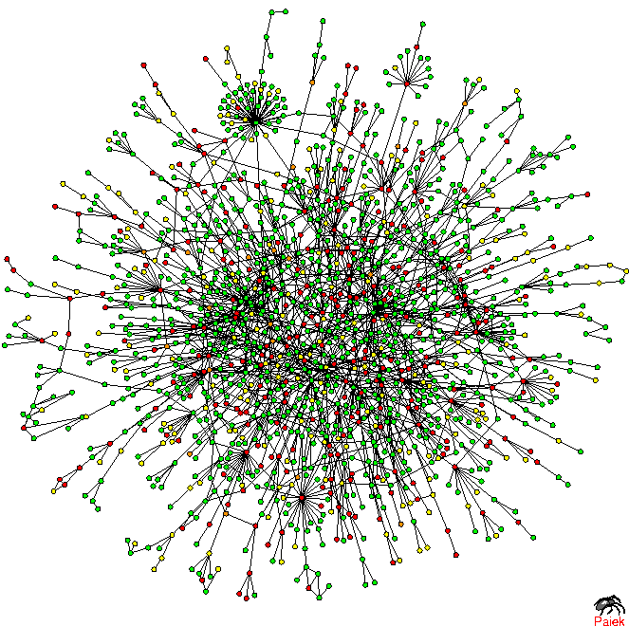
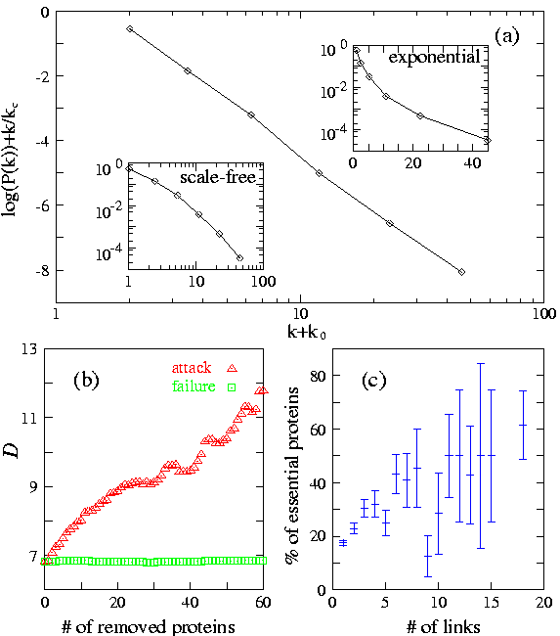
Prot P(k)
TOPOLOGY OF THE PROTEIN NETWORK
Nodes: proteins
Links: physical interactions-binding
H. Jeong, S.P. Mason, A.-L. Barabasi, Z.N. Oltvai, Nature 411, 41-42 (2001)

Slide 36
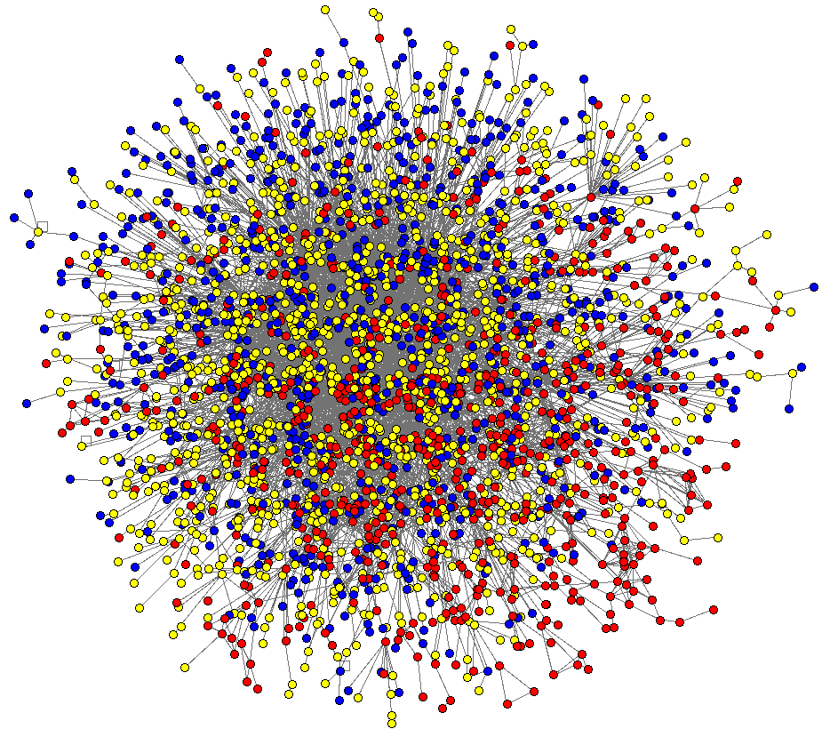
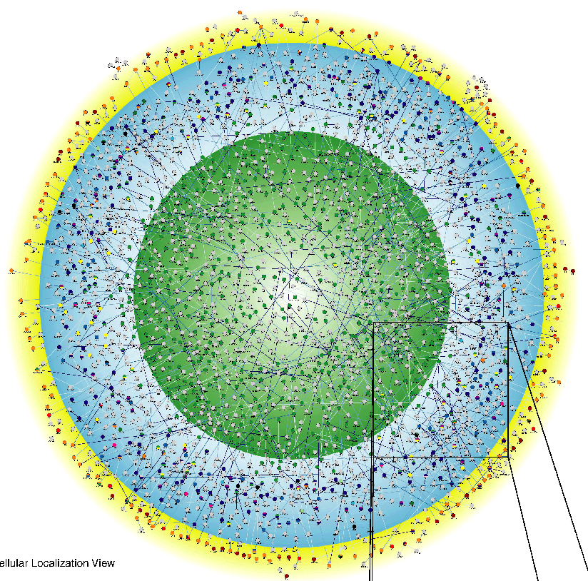
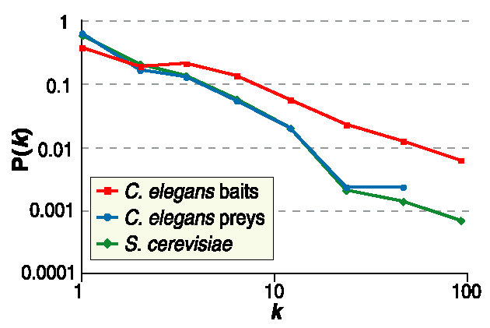
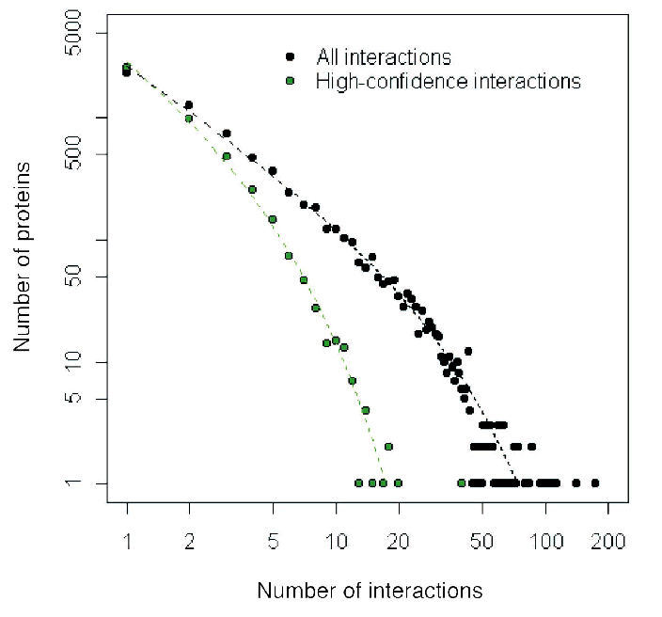
C. Elegans
Drosophila M.
Giot et al. Science 2003
Li et al. Science 2004
Network Science: Scale-Free Networks

Slide 37
Section 2
Growth and preferential attachment

Slide 38
Barabasi-Albert model Definition
The recognition that growth and preferential attachment coexist in real networks has
inspired a minimal model called the Barabási-Albert model (BA model), which
generates scale-free networks [1], defined as follows:
We start with m₀ nodes, the links between which are chosen arbitrarily, as long as each
node has at least one link. The network develops following two steps:
Growth: at each timestep we add a new node with m (≤ m₀) links that connect the
new node to m nodes already in the network.
Preferential attachment: the probability Π(k) that a link of the new node connects to
node i depends on the degree k_{i} as Π(k_{i})=k_{i}∑_{j} k_{j}
Preferential attachment is a probabilistic mechanism: a new node is free to connect to
any node in the network, whether it is a hub or has a single link. However, that if a new
node has a choice between a degree-two and a degree-four node, it is twice as likely that
it connects to the degree-four node.
[1] A.-L.Barabási, R. Albert and H. Jeong, Physica A 272, 173 (1999)
Network Science: Evolving Network Models
Notes:
PREDICTIONS:
(i) The degree exponent $\gamma$ is independent of $m$, a prediction that is in agreement with the numerical results (see Fig. 4).
(ii) As the power-law observed for real networks describes systems of rather different ages and sizes, it is expected that a correct model should provide a time-independent degree distribution. Indeed, Eq.(\ref{cube}) predicts that asymptotically (i.e. in the $t \gg m_0$ limit) the degree distribution of the BA model is independent of time (and, subsequently, independent of the system size $N=m_0+t$), indicating that despite its continuous growth, the network reaches a stationary scale-free state.
Nominal similarities shown in Figure 4 support these predictions.
(iii) Equation (\ref{cube}) indicates that the coefficient of the power-law distribution is proportional to $m^2$. a prediction again confirmed by the numerical simulations shown in Figure \ref{F-BA-BAScaling}.

Slide 39
Section 4 Linearized Chord Diagram
Possible evolution
paths with self-loops.
New node is red.
One possible definition with self-loops

Slide 40
Section 4
Degree dynamics

Slide 41
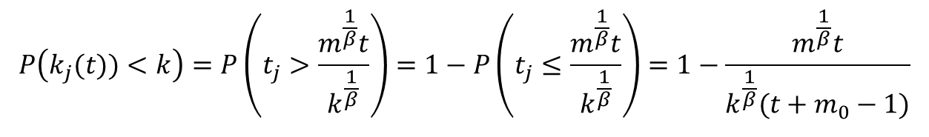
Degree distribution for Barabasi-Albert model
for t ≥ m₀+i and 0 otherwise as system size at t is N=m₀+t-1
We assume the initial m₀ nodes create a fully connected graph.
A random node j arriving at time t is with equal probability 1/N=1/(m₀+t-1) one of the nodes 1, 2,…. N, its degree will grow with the above equation, so
$$P\left(k_{j}(t))<k\right)=P\left(t_{j}>\frac{m^{\frac{1}{β}}t}{k^{\frac{1}{β}}}\right)=1−P\left(t_{j}≤\frac{m^{\frac{1}{β}}t}{k^{\frac{1}{β}}}\right)=1−\frac{m^{\frac{1}{β}}t}{k^{\frac{1}{β}}(t+m_{0}−1)}$$
For the large times t (and so large network sizes) we can replace t-1 with t above, so
γ = 3
A.-L.Barabási, R. Albert and H. Jeong, Physica A 272, 173 (1999)
Network Science: Evolving Network Models
Notes:
PREDICTIONS:
(i) The degree exponent $\gamma$ is independent of $m$, a prediction that is in agreement with the numerical results (see Fig. 4).
(ii) As the power-law observed for real networks describes systems of rather different ages and sizes, it is expected that a correct model should provide a time-independent degree distribution. Indeed, Eq.(\ref{cube}) predicts that asymptotically (i.e. in the $t \gg m_0$ limit) the degree distribution of the BA model is independent of time (and, subsequently, independent of the system size $N=m_0+t$), indicating that despite its continuous growth, the network reaches a stationary scale-free state.
Nominal similarities shown in Figure 4 support these predictions.
(iii) Equation (\ref{cube}) indicates that the coefficient of the power-law distribution is proportional to $m^2$. a prediction again confirmed by the numerical simulations shown in Figure \ref{F-BA-BAScaling}.

Slide 42
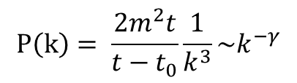
Degree distribution
$$P\left(k\right)= \frac{2m^{2}t}{t−t_{0}}\frac{1}{k^{3}}\sim k^{−γ}$$
γ = 3
(i) The degree exponent is independent of m.
(ii) As the power-law describes systems of rather different ages and sizes, it is expected that a correct model should provide a time-independent degree distribution. Indeed, asymptotically the degree distribution of the BA model is independent of time (and of the system size N)
→ the network reaches a stationary scale-free state.
(iii) The coefficient of the power-law distribution is proportional to m².
A.-L.Barabási, R. Albert and H. Jeong, Physica A 272, 173 (1999)
Network Science: Evolving Network Models
Notes:
PREDICTIONS:
(i) The degree exponent $\gamma$ is independent of $m$, a prediction that is in agreement with the numerical results (see Fig. 4).
(ii) As the power-law observed for real networks describes systems of rather different ages and sizes, it is expected that a correct model should provide a time-independent degree distribution. Indeed, Eq.(\ref{cube}) predicts that asymptotically (i.e. in the $t \gg m_0$ limit) the degree distribution of the BA model is independent of time (and, subsequently, independent of the system size $N=m_0+t$), indicating that despite its continuous growth, the network reaches a stationary scale-free state.
Nominal similarities shown in Figure 4 support these predictions.
(iii) Equation (\ref{cube}) indicates that the coefficient of the power-law distribution is proportional to $m^2$. a prediction again confirmed by the numerical simulations shown in Figure \ref{F-BA-BAScaling}.

Slide 43
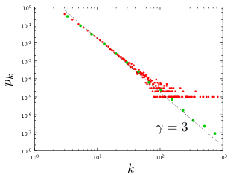
Section 4
Notes:
The degree distribution of a network generated by the Barabási-Albert model. The plot show for a single network of size N=100,000 and m=3 and . It shows both the linearly-binned (red symbols) as well as the log-binned version (green symbols) o. The straight line is added to guide the eye and has slope -3, corresponding to the resulting network’s degree exponent.

Slide 44
NUMERICAL SIMULATION OF THE BA MODEL

Slide 45
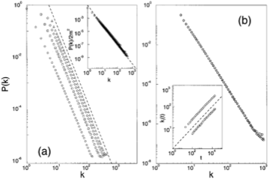

NUMERICAL SIMULATION OF THE BA MODEL
m=1,3,5,7
N=100,000;150,000;200,000
m-dependence
Stationarity:
P(k) independent of N
Insert:
degree dynamics
Network Science: Evolving Network Models

Slide 46
The mean field theory offers the correct scaling, BUT it provides the wrong coefficient of the degree distribution.
So assymptotically it is correct (k→ ∞), but not correct in details (particularly for small k).
To fix it, we need to calculate P(k) exactly, which we will do next using a rate equation based approach.
Network Science: Evolving Network Models

Slide 47
MFT - Degree Distribution: Rate Equation
Number of nodes with degree k at time t.
Since at each timestep we add one node, we have N=t (total number of nodes = number of timesteps)
2m: each node adds m links, but each link contributed to the degree of 2 nodes
Total number of k-nodes
Number of links added to degree k nodes after the arrival of a new node:
Nr. of degree k-1 nodes that acquire a new link, becoming degree k
New node adds m new links to other nodes
Preferential attachment
Nr. of degree k nodes that acquire a new link, becoming degree k+1
# k-nodes at time t+1
# k-nodes at time t
Gain of k-nodes via
k-1→ k
Loss of k-nodes via
k→ k+1
A.-L.Barabási, R. Albert and H. Jeong, Physica A 272, 173 (1999)

Slide 48
MFT - Degree Distribution: Rate Equation
# k-nodes at time t+1
# k-nodes at time t
Gain of k-nodes via
k-1→ k
Loss of k-nodes via
k→ k+1
We do not have k=0,1,...,m-1 nodes in the network (each node arrives with degree m)
→ We need a separate equation for degree m modes
# m-nodes at time t+1
# m-nodes at time t
Add one
m-degeree node
Loss of an
m-node via
m→ m+1
A.-L.Barabási, R. Albert and H. Jeong, Physica A 272, 173 (1999)
Network Science: Evolving Network Models

Slide 49
MFT - Degree Distribution: Rate Equation
k>m
We assume that there is a stationary state in the N=t→∞ limit, when P(k,∞)=P(k)
k>m
Network Science: Evolving Network Models

Slide 50
MFT - Degree Distribution: Rate Equation
➔
m+3 → k
...
for large k
Krapivsky, Redner, Leyvraz, PRL 2000
Dorogovtsev, Mendes, Samukhin, PRL 2000
Bollobas et al, Random Struc. Alg. 2001
Network Science: Evolving Network Models

Slide 51
MFT - Degree Distribution: A Pretty Caveat
Start from eq.
Its solution is:
Dorogovtsev and Mendes, 2003
Network Science: Evolving Network Models

Slide 52
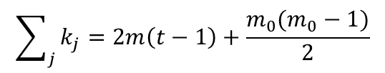
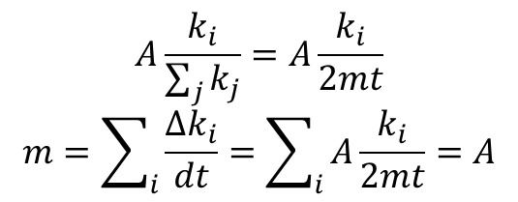
All nodes follow the same growth law
$$A\frac{k_{i}}{\sum_{j}{k_{j}}}=A\frac{k_{i}}{2mt}$$
$$m=\sum_{i}{\frac{∆k_{i}}{dt}}=\sum_{i}{A\frac{k_{i}}{2mt}=A}$$
In limit:
So:
$$\sum_{j}{k_{j}=2m\left(t−1\right)+\frac{m_{0}(m_{0}−1)}{2}}$$
Use:
During a unit time (time step): Δk=m → A=m
β: dynamical exponent
A.-L.Barabási, R. Albert and H. Jeong, Physica A 272, 173 (1999)
Network Science: Evolving Network Models
Notes:
This is an important prediction, as it implies that all nodes follow the same growth law. Hence the difference between the hubs is not in the fact that hubs grow faster, but that they are older. Indeed, the difference between the nodes comes in the intercept of the power-law, controlled by $t_i$, representing the time at which node $i$ joined the network.
If all nodes follow the same growth rate, why do we have hubs and less connected nodes in the network? The reason is that at moment older nodes have a higher degree according to Eq. \ref{connect}--indeed, the smaller $t_i$ is, the higher is the node's degree. As a consequence older nodes acquire more links in an unit time. This is seen by inspective the derivative of Eq. \ref{connect}, which is nothing but the node's growth rate (i.e. the rate at which the node acquires new links)
with predicts two things. First, it tells is that the older the node is (i.e. the smaller $t_i$ is), the larger the growth rate. Second, it also tells us that with time the rate at which the nodes acquire links goes down, thanks to the fact that the new nodes have many more nodes to link to.

Slide 53
Fitness Model
Network Science: Evolving Network Models

Slide 54
Fitness Model: Can Latecomers Make It?
SF model: k(t)~t ^{½} (first mover advantage)
Fitness model: fitness (η ) k(η,t)~t^{β(η)}
β(η) =η/C
Degree (k)
time
Bianconi & Barabási, Physical Review Letters 2001; Europhys. Lett. 2001.

Slide 55
Section 5.3

Slide 56
Section 6
Absence of growth and preferential attachment

Slide 57
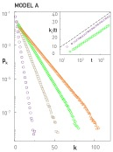
MODEL A
growth preferential attachment
Π(k_{i}) : uniform

Slide 58
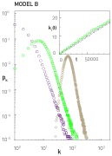
MODEL B
growth preferential attachment
p_{k} : power law (initially) →
→ Gaussian → Fully Connected

Slide 59
Do we need both growth and preferential attachment?
YEP
Network Science: Evolving Network Models

Slide 60


Regular network
EMPIRICAL DATA FOR REAL NETWORKS
Pathlenght
Clustering
Degree Distr.
P(k) ~ k^{-γ}
P(k)=δ(k-k_{d})
Erdos-
Renyi
Watts-
Strogatz
Exponential
Barabasi-Albert
P(k) ~ k^{-γ}
Network Science: Evolving Network Models
Notes:
As a universal feature, they do well in clustering and the path lenghts. However, they all fail in the degree distribution. Hence we need models the fix that problem. As will see, this is not a trivial feature– many properties of real networks are determined primarily by the degree distribution.

Slide 61
Section 9
The origins of preferential attachment
Notes:
Given the important role preferential attachment plays in the evolution of real networks, we must ask: where does preferential attachment come from? Specifically,
Why does depend on ?
Why is the dependence of linear in k ?
There are two philosophically different takes on these questions. The first approach views preferential attachment as an interplay between random events and some structural network property. These mechanisms do not require global knowledge of the network. Hence we will call them local or random mechanisms. The second approach assumes that the addition of each new node or link is preceeded by a cost-benefit analysis, balancing various needs with the available resources. This assumes familiarity with the whole network and relies on optimization principles, prompting us to call them global or optimized mechanisms. The purpose of this section is to discuss these two approaches.

Slide 62
Section 9 Link selection model
Link selection model -- perhaps the simplest example of a local or random mechanism capable of generating preferential attachment.
Growth: at each time step we add a new node to the network.
Link selection: we select a link at random and connect the new node to one of nodes at the two ends of the selected link.
To show that this simple mechanism generates linear preferential attachment, we write the probability that the node
at the end of a randomly chosen link has degree k as

Slide 63
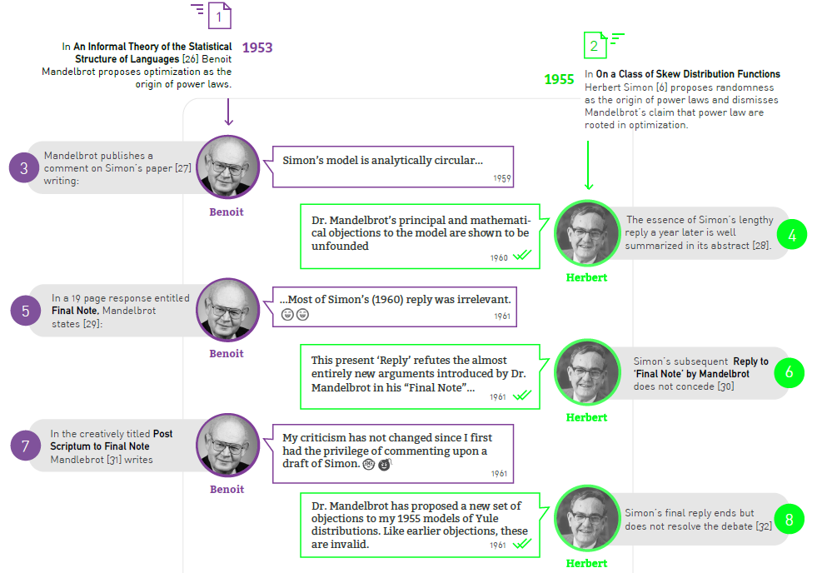
Section 9 Originators of preferential attachments
Notes:
Given the important role preferential attachment plays in the evolution of real networks, we must ask: where does preferential attachment come from? Specifically,
Why does depend on ?
Why is the dependence of linear in k ?
There are two philosophically different takes on these questions. The first approach views preferential attachment as an interplay between random events and some structural network property. These mechanisms do not require global knowledge of the network. Hence we will call them local or random mechanisms. The second approach assumes that the addition of each new node or link is preceeded by a cost-benefit analysis, balancing various needs with the available resources. This assumes familiarity with the whole network and relies on optimization principles, prompting us to call them global or optimized mechanisms. The purpose of this section is to discuss these two approaches.

Slide 64
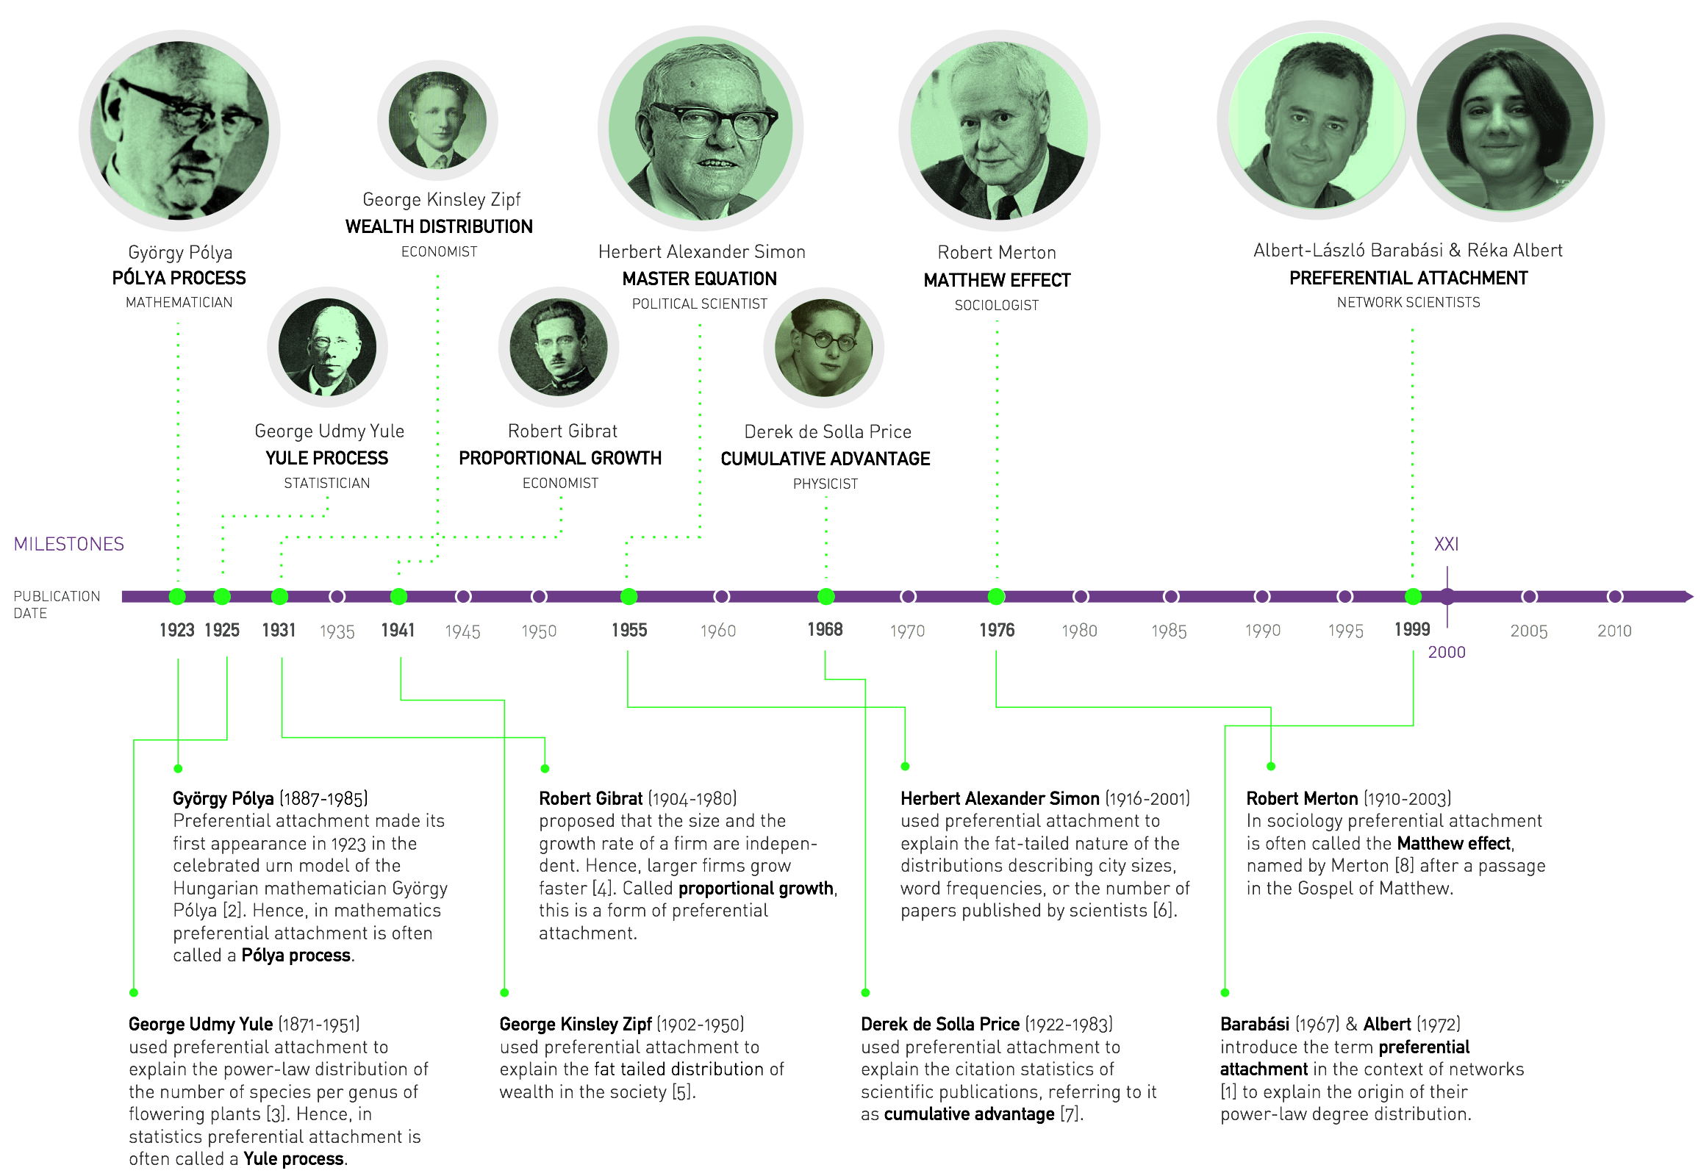
Notes:
The discovery of the Barabási-Albert model is recounted in Linked [9], describing a workstop in Porto, Portugal, attended by the first author of the model: “During the summer of 1999 very few people were thinking about networks, and there were no talks on the subject during this workshop. But networks were very much on my mind. I could not help carrying with me on the trip our unresolved questions: Why hubs? Why power-laws? […] Before I left for Europe, Réka Albert and I agreed that she would analyze these networks. On June 14, a week after my departure, I received a long email from her detailing some ongoing activities. At the end of the message there was a sentence added like an afterthought: “I looked at the connectivity distribution too, and in almost all systems (IBM, actors, power grid), the tail of the distribution follows a power law.” Réka’s email suddenly made it clear that the Web was by no means special. I found myself sitting in the conference hall paying no attention to the talks, thinking about the implications of this finding. If two networks as different as the Web and the Hollywood acting community both display power-law degree distribution, then some universal law or mechanism must be responsible. If such a law existed, it could potentially apply to all networks. During the first break between talks I decided to withdraw to the quiet of the seminary where we were housed during the workshop. I did not get far, however. During the fifteen-minute walk back to my room a potential explanation occurred to me, one so simple and straightforward that I doubted it could be right. I immediately returned to the university to fax Réka, asking her to verify the idea using the computer. A few hours later she emailed me the answer. To my great astonishment, the idea worked.” The two images above reproduce the fax sent on June 14, 1999 from Porto, describing the algorithm that we call today the Barabási-Albert model.

